Slide 1

Work Review
yxchen
2014/5/9
Copyright © 2011 MoboTap Inc. All rights reserved.

Slide 2
适配方式
当前的适配方式
kResolutionExactFit
会直接按照长宽拉伸，会导致图案变形
合适的适配方式
kResolutionNoBorder
以稍短边为比例缩放（长边会超出）
kResolutionShowAll
以长边为比例缩放（会留黑边）
其他
kResolutionFixedHeight
kResolutionFixedWidth

Slide 3
适配方案
kResolutionShowAll
黑边无法填充
使用kResolutionNoBorder

Slide 4

适配方案
但

Slide 5
适配方案
动态获取WinSize
CCSize frameSize = pEGLView->getFrameSize();
CCSize resoSize = CCSizeMake(960, 640);
float scaleX = (float) frameSize.width / resoSize.width;
float scaleY = (float) frameSize.height / resoSize.height;
float scale = 0.0f; // MAX(scaleX, scaleY);
if (scaleX > scaleY) {
scale = scaleX / (frameSize.height / (float) resoSize.height);
} else {
scale = scaleY / (frameSize.width / (float) resoSize.width);
}
pEGLView->setDesignResolutionSize(resoSize.width * scale, resoSize.height * scale, kResolutionNoBorder);

Slide 6
适配方案
比如设计大小400*320
屏幕大小1200*640
按照方式二，WinSize为600*400
而等比放大系数为2
即按照宽度来放大可操作区域
按照高度来放大可见区域

Slide 7
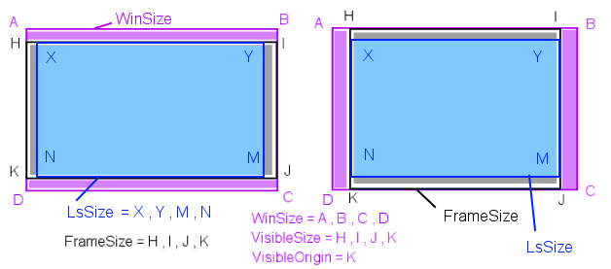
适配方案

Slide 8

效果

Slide 9
处理
Resource.h
#define DESIGN_WIDTH 960
#define DESIGN_HEIGHT 640
#define WIN_SIZE_WIDTH CCDirector::sharedDirector()->getWinSize().width
#define WIN_SIZE_HEIGHT CCDirector::sharedDirector()->getWinSize().height
#define SUITABLE_SIZE_WIDTH(size_x) ((size_x))
#define SUITABLE_SIZE_HEIGHT(size_y) ((size_y) * WIN_SIZE_HEIGHT / DESIGN_HEIGHT * DESIGN_WIDTH / WIN_SIZE_WIDTH)
#define SUITABLE_ORIGIN_X ((WIN_SIZE_WIDTH - DESIGN_WIDTH) /2)
#define SUITABLE_ORIGIN_Y CCDirector::sharedDirector()->getVisibleOrigin().y

Slide 10
处理
Resource.h
#define ccpFromCenter(pos_x, pos_y) ccpAdd(ccp(WIN_SIZE_WIDTH/2, WIN_SIZE_HEIGHT/2), ccp(SUITABLE_SIZE_WIDTH(pos_x), SUITABLE_SIZE_HEIGHT(pos_y)))
//无黑边区域左下角为起始点
#define ccpFromSuitOrigin(pos_x, pos_y) ccpAdd(ccp(SUITABLE_ORIGIN_X, SUITABLE_ORIGIN_Y), ccp(SUITABLE_SIZE_WIDTH(pos_x), SUITABLE_SIZE_HEIGHT(pos_y)))
//屏幕左下角为起始点
#define ccpFromVisOrigin(pos_x, pos_y) ccpAdd(CCDirector::sharedDirector()->getVisibleOrigin(), ccp(SUITABLE_SIZE_WIDTH(pos_x), SUITABLE_SIZE_HEIGHT(pos_y)))

Slide 11
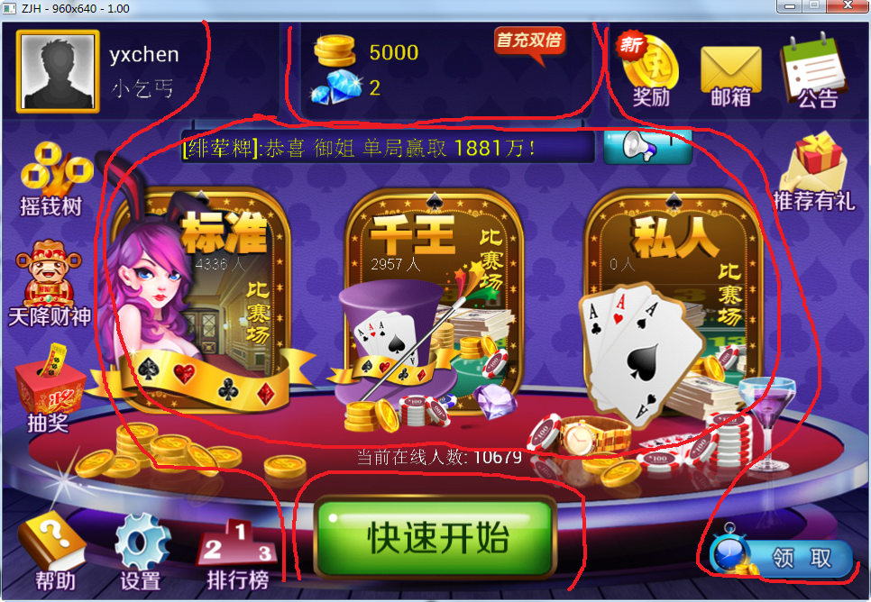
处理

Slide 12

result

Slide 13

result

Slide 14
Q&A

Slide 15
Thanks!

Slide 16

Smart phone. Clever browsing

